Slide 1
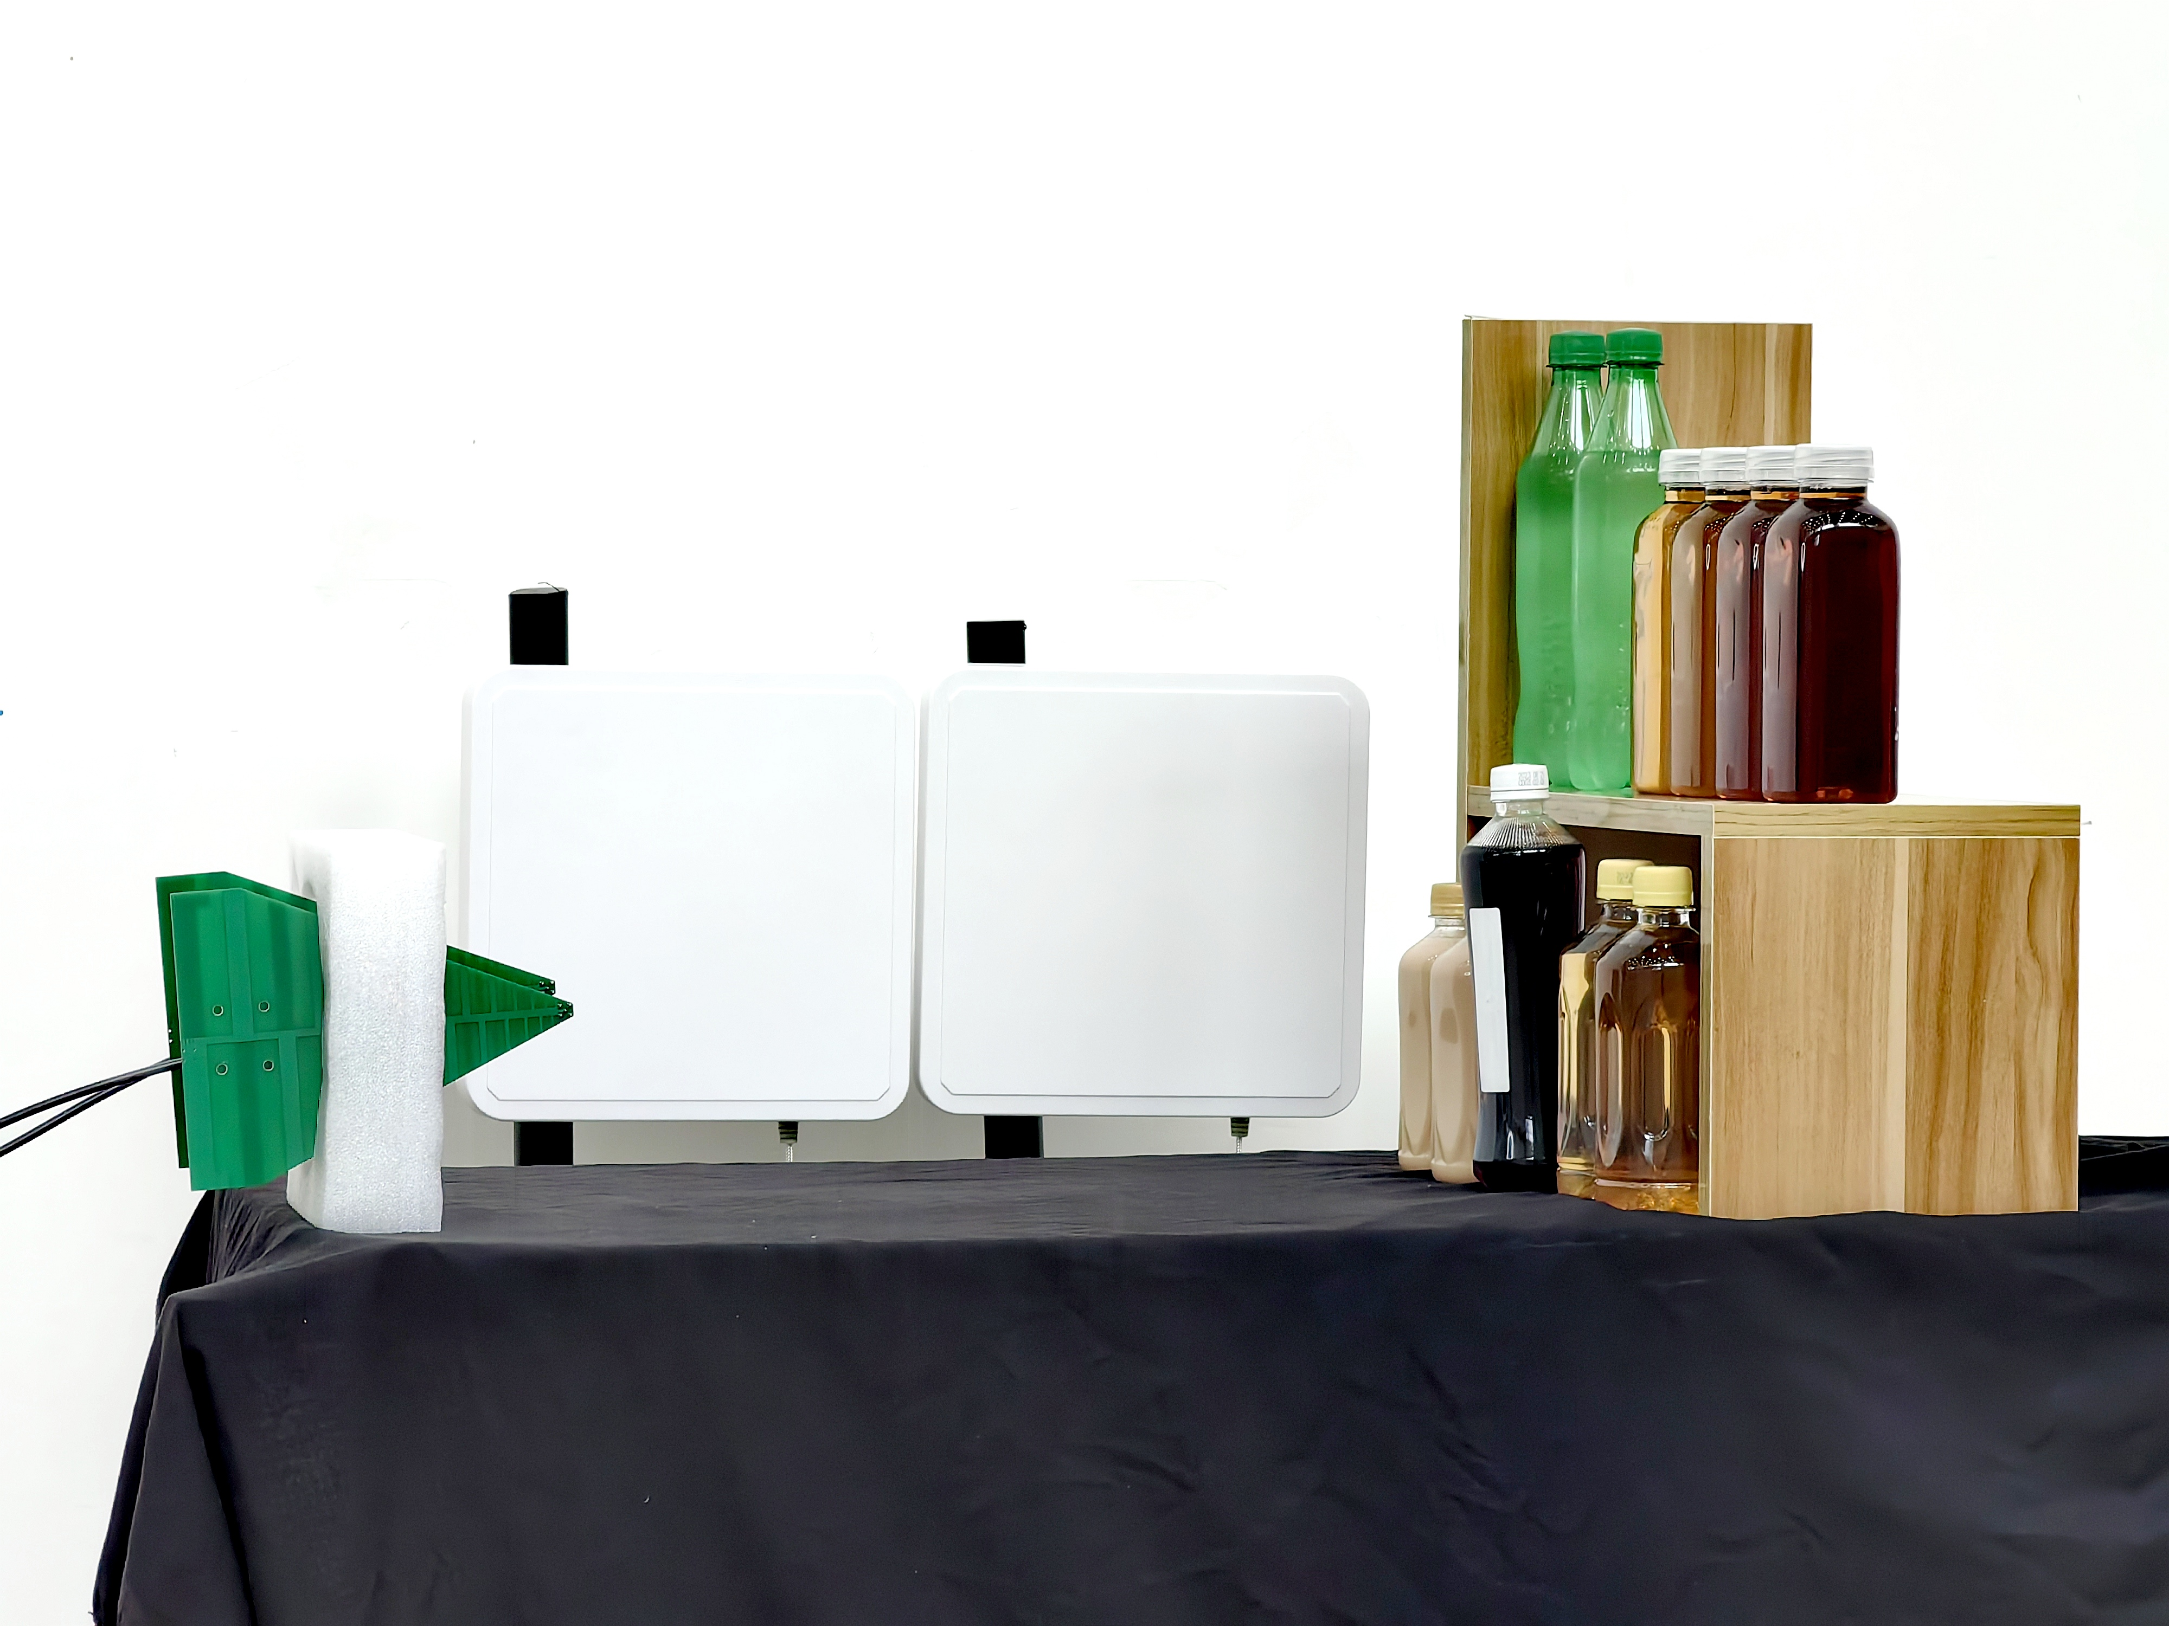
Two Antennas
Tag
Two Log-periodic antennas

Slide 2
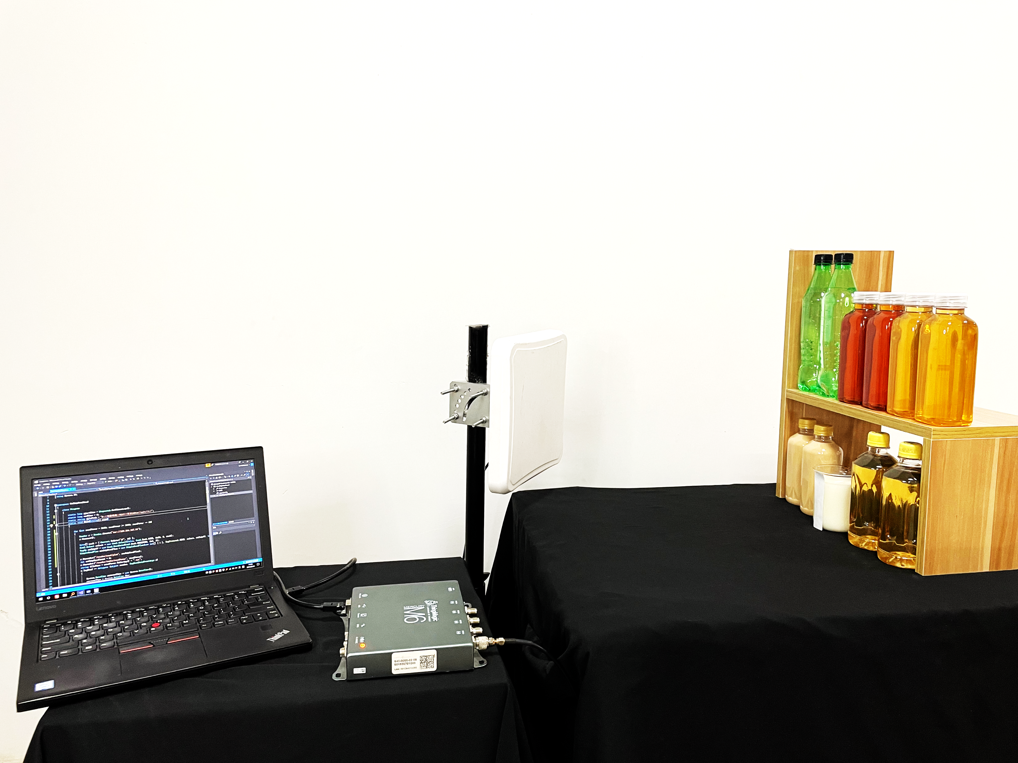
Antenna
Laptop
Tag
Reader

Slide 3
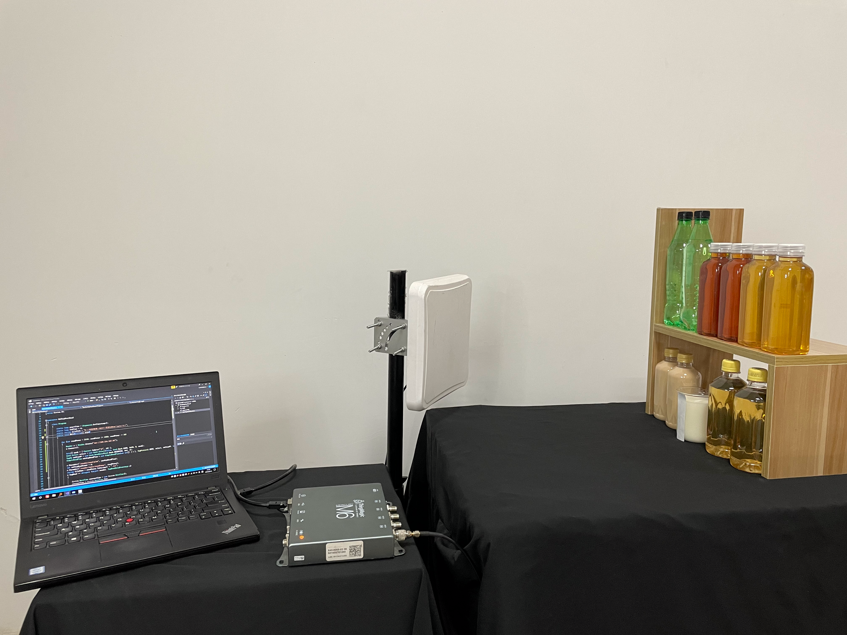
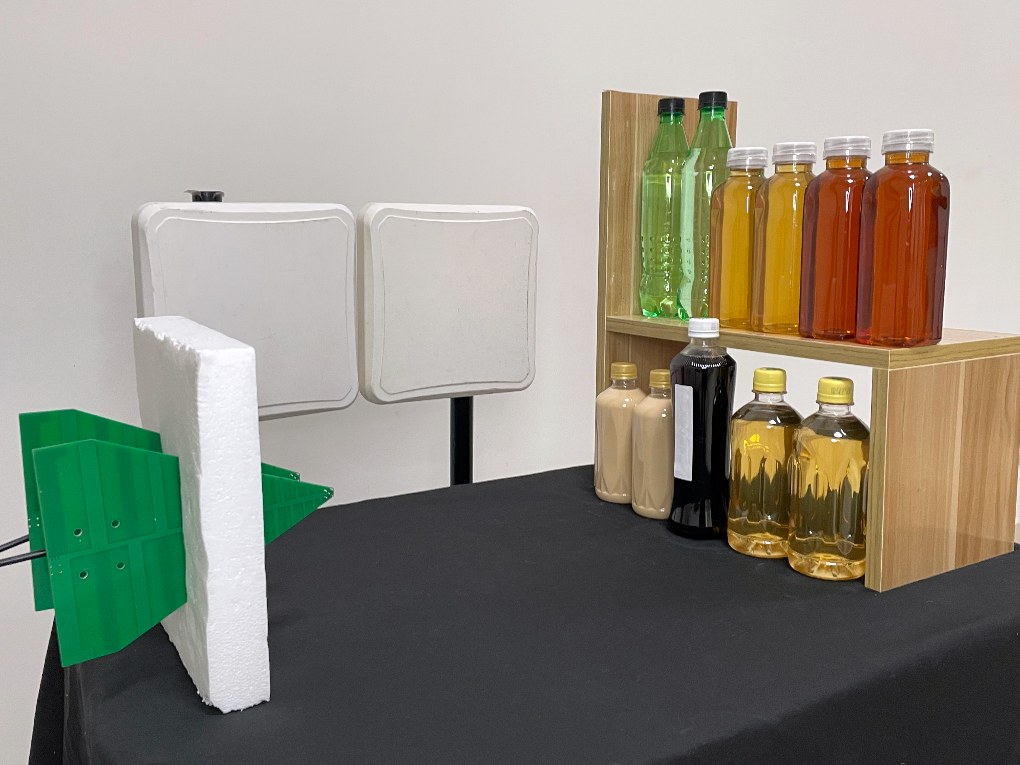
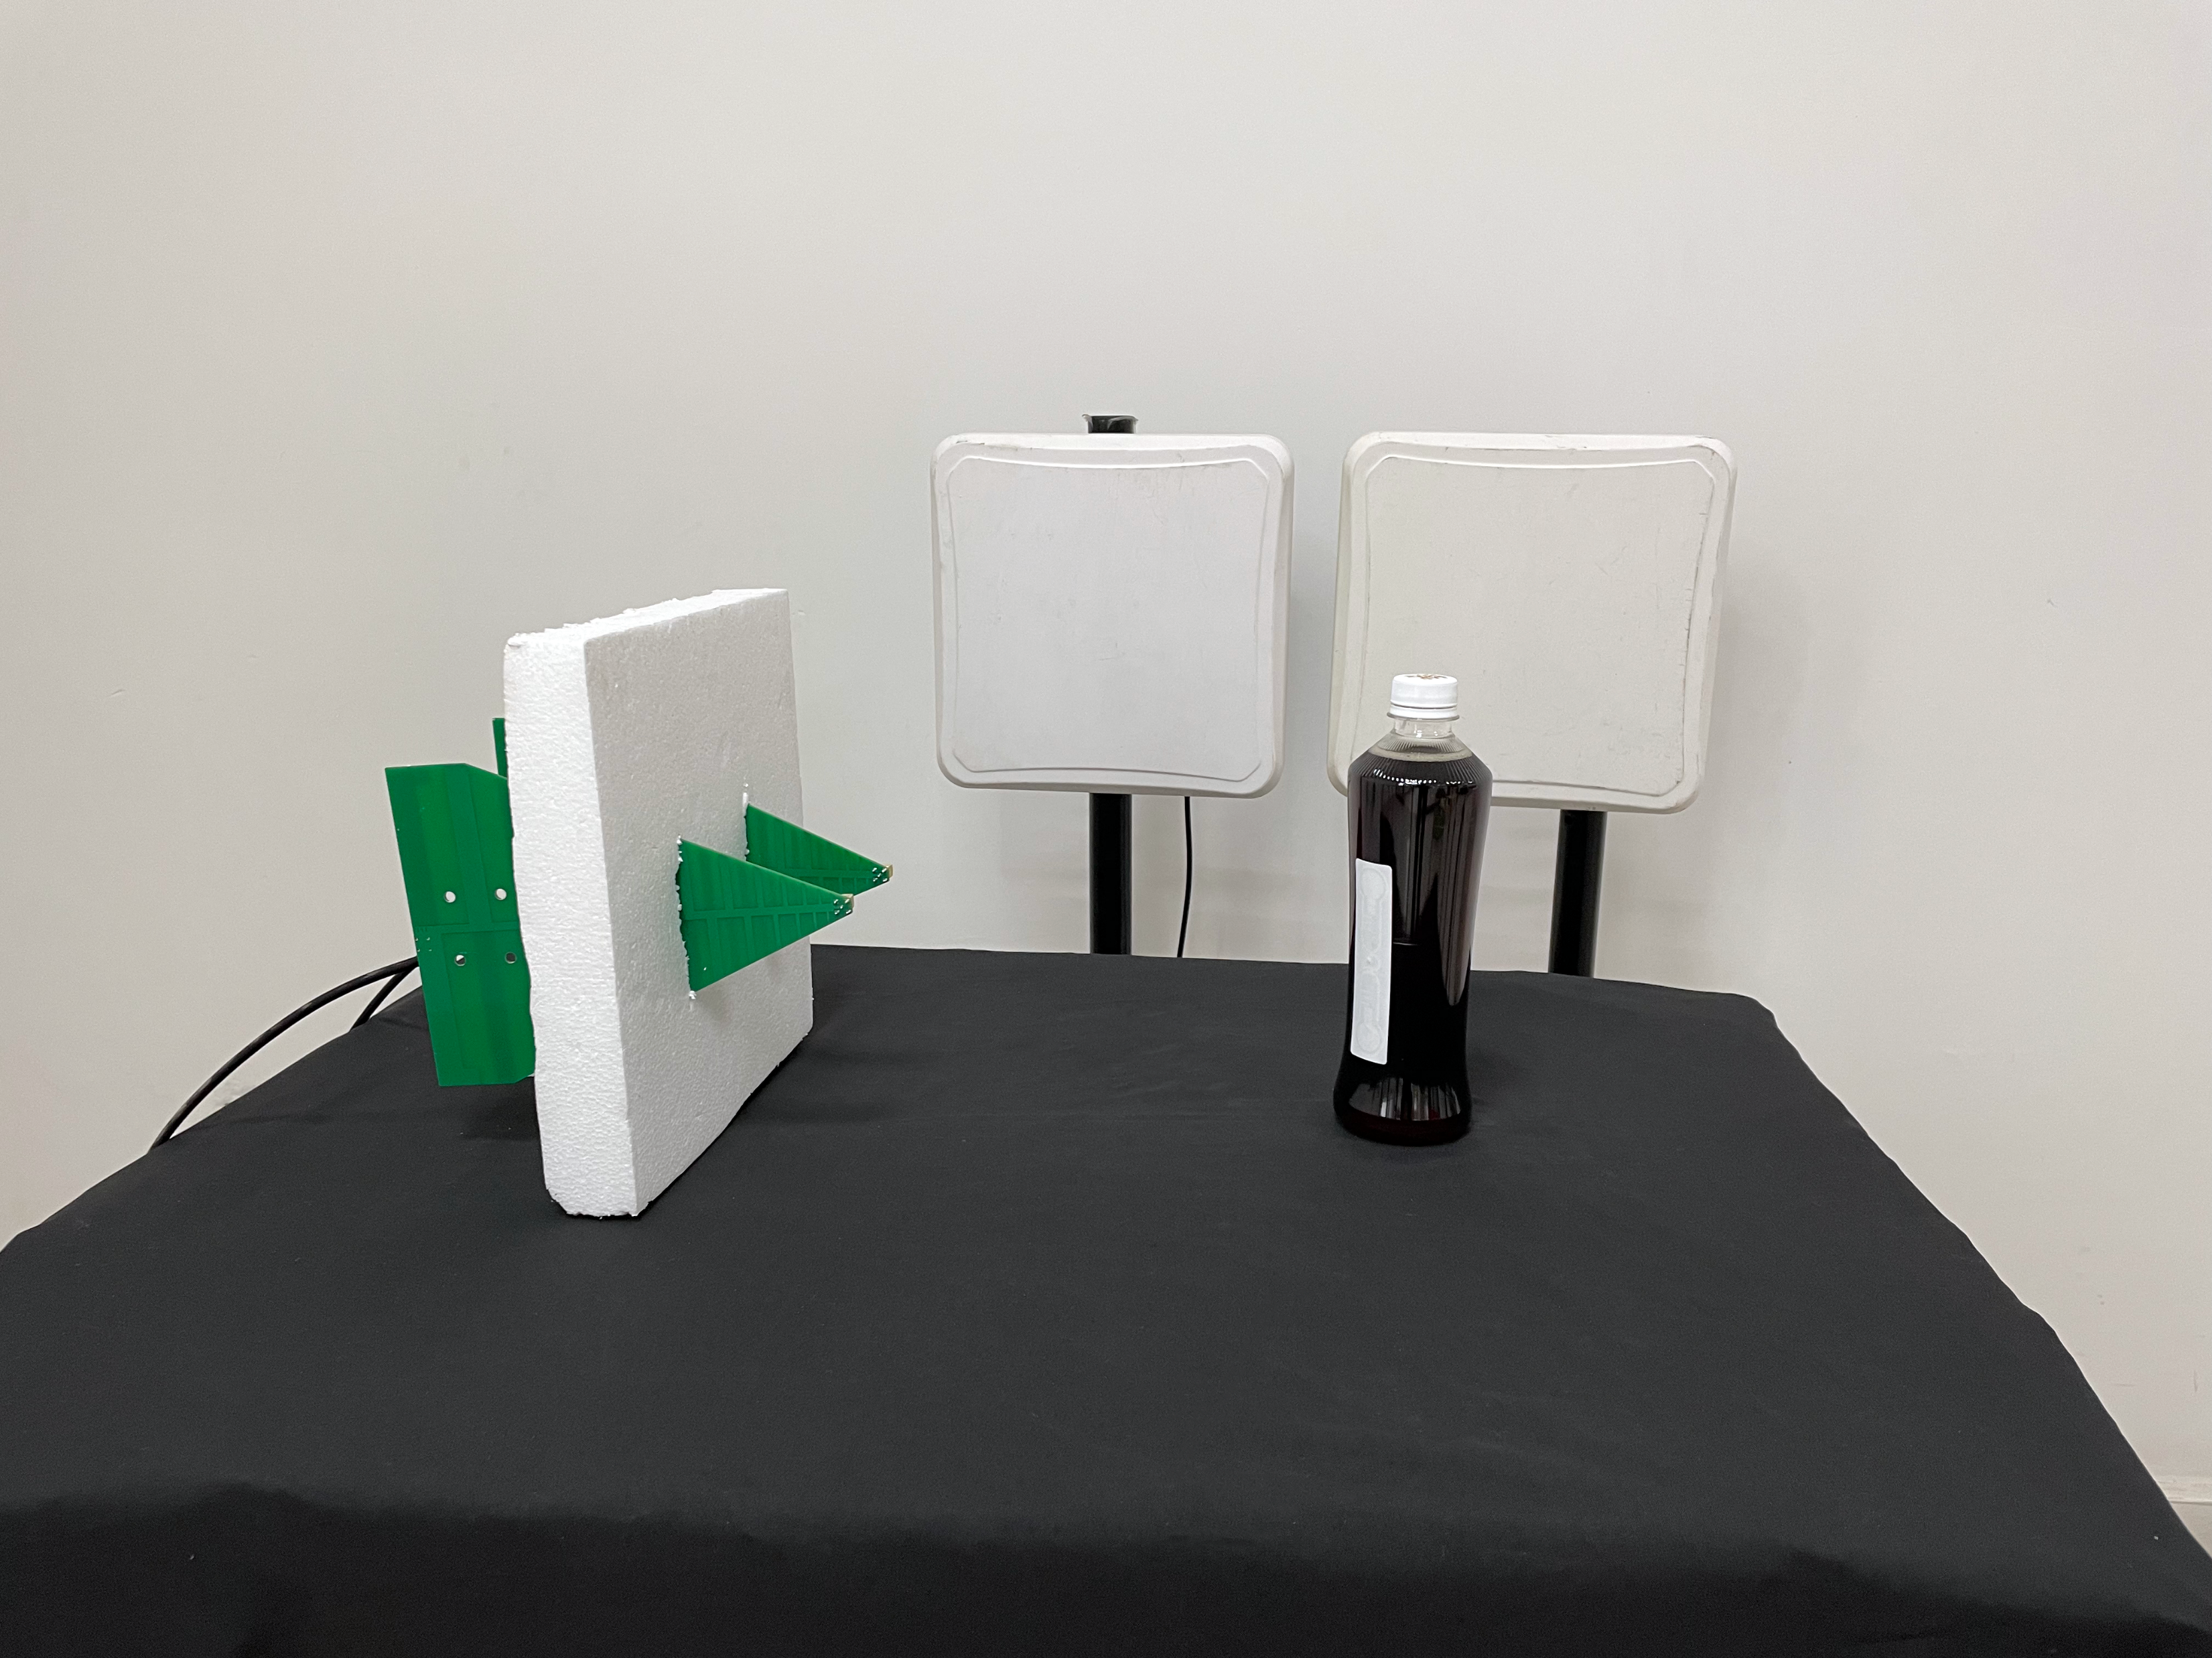
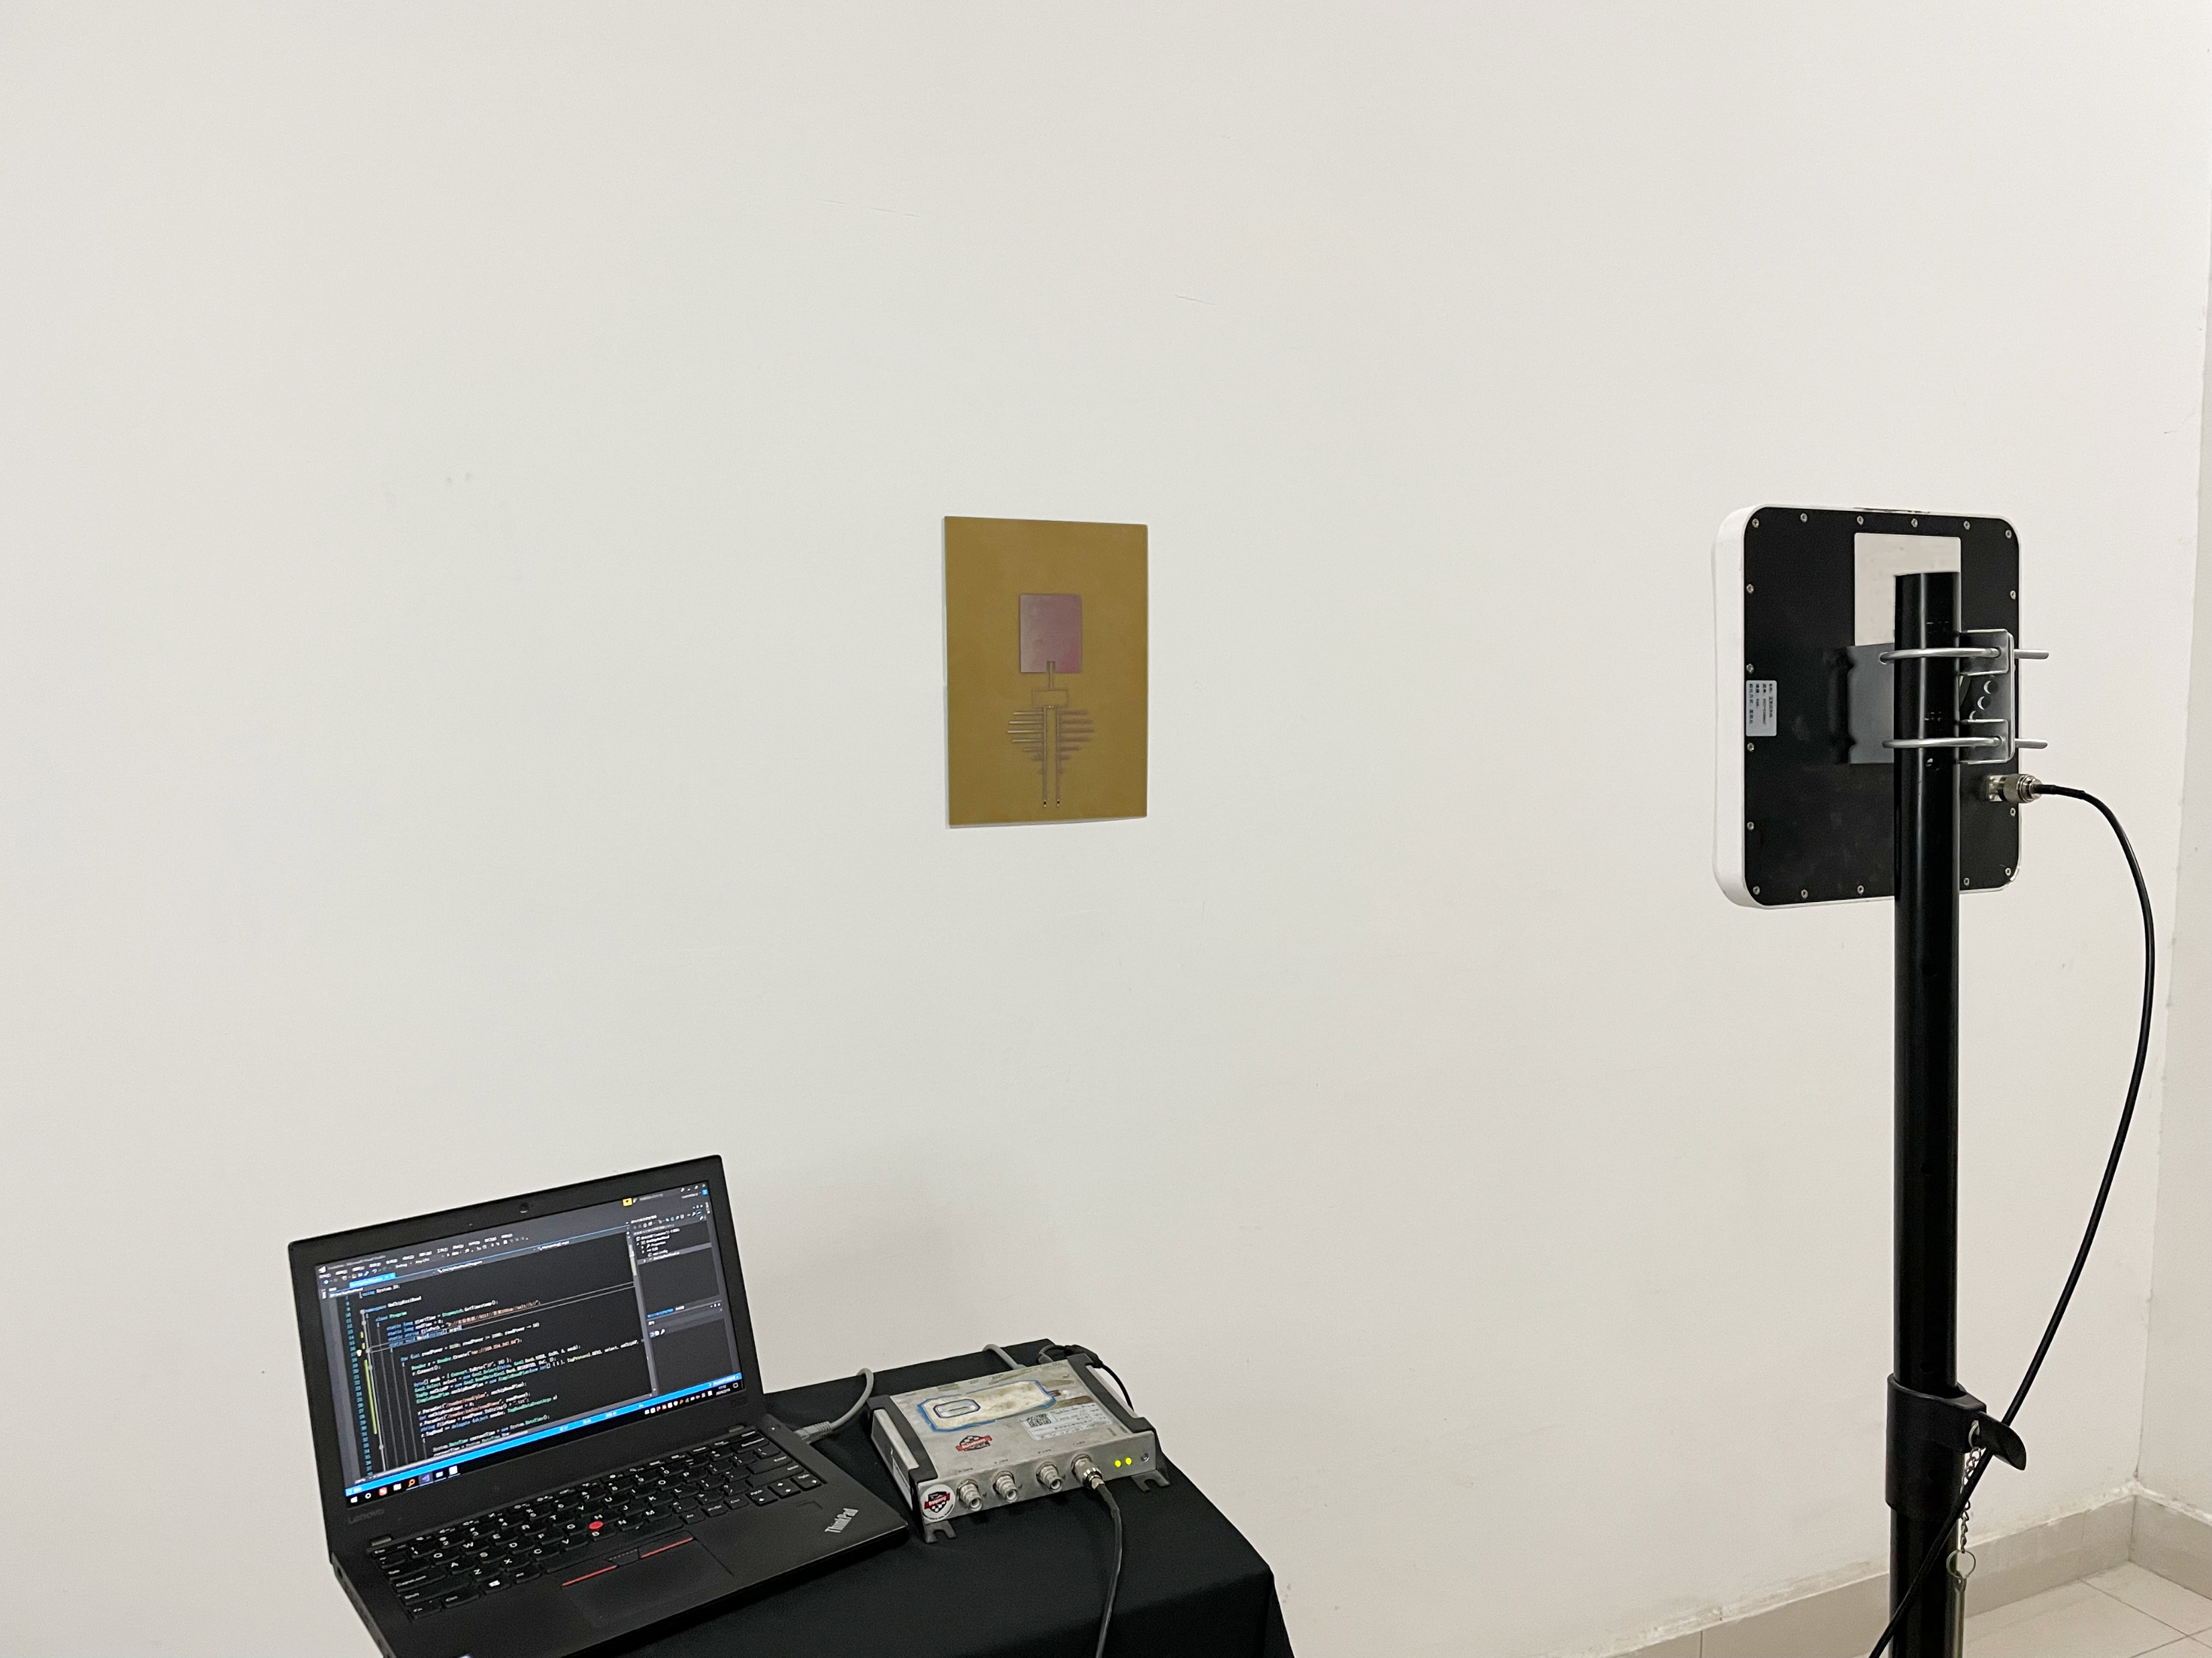
Antenna
Tx Rx Antenna
Antenna
Laptop
Tag
Tag
Tag
Tx Rx Antenna
Reader
Antenna
Keystub
Antenna
Laptop
Reader

Slide 4
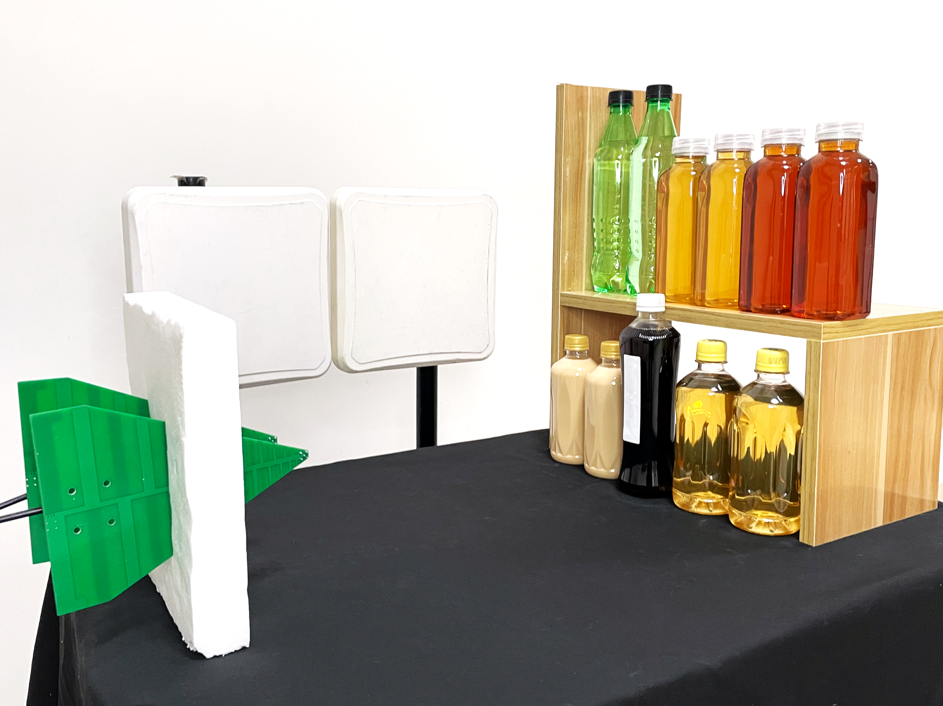
Antenna
Tag
Antenna

Slide 5

Antenna
Laptop
Tag
Reader

Slide 6
Antenna
Tag
Antenna

Slide 7
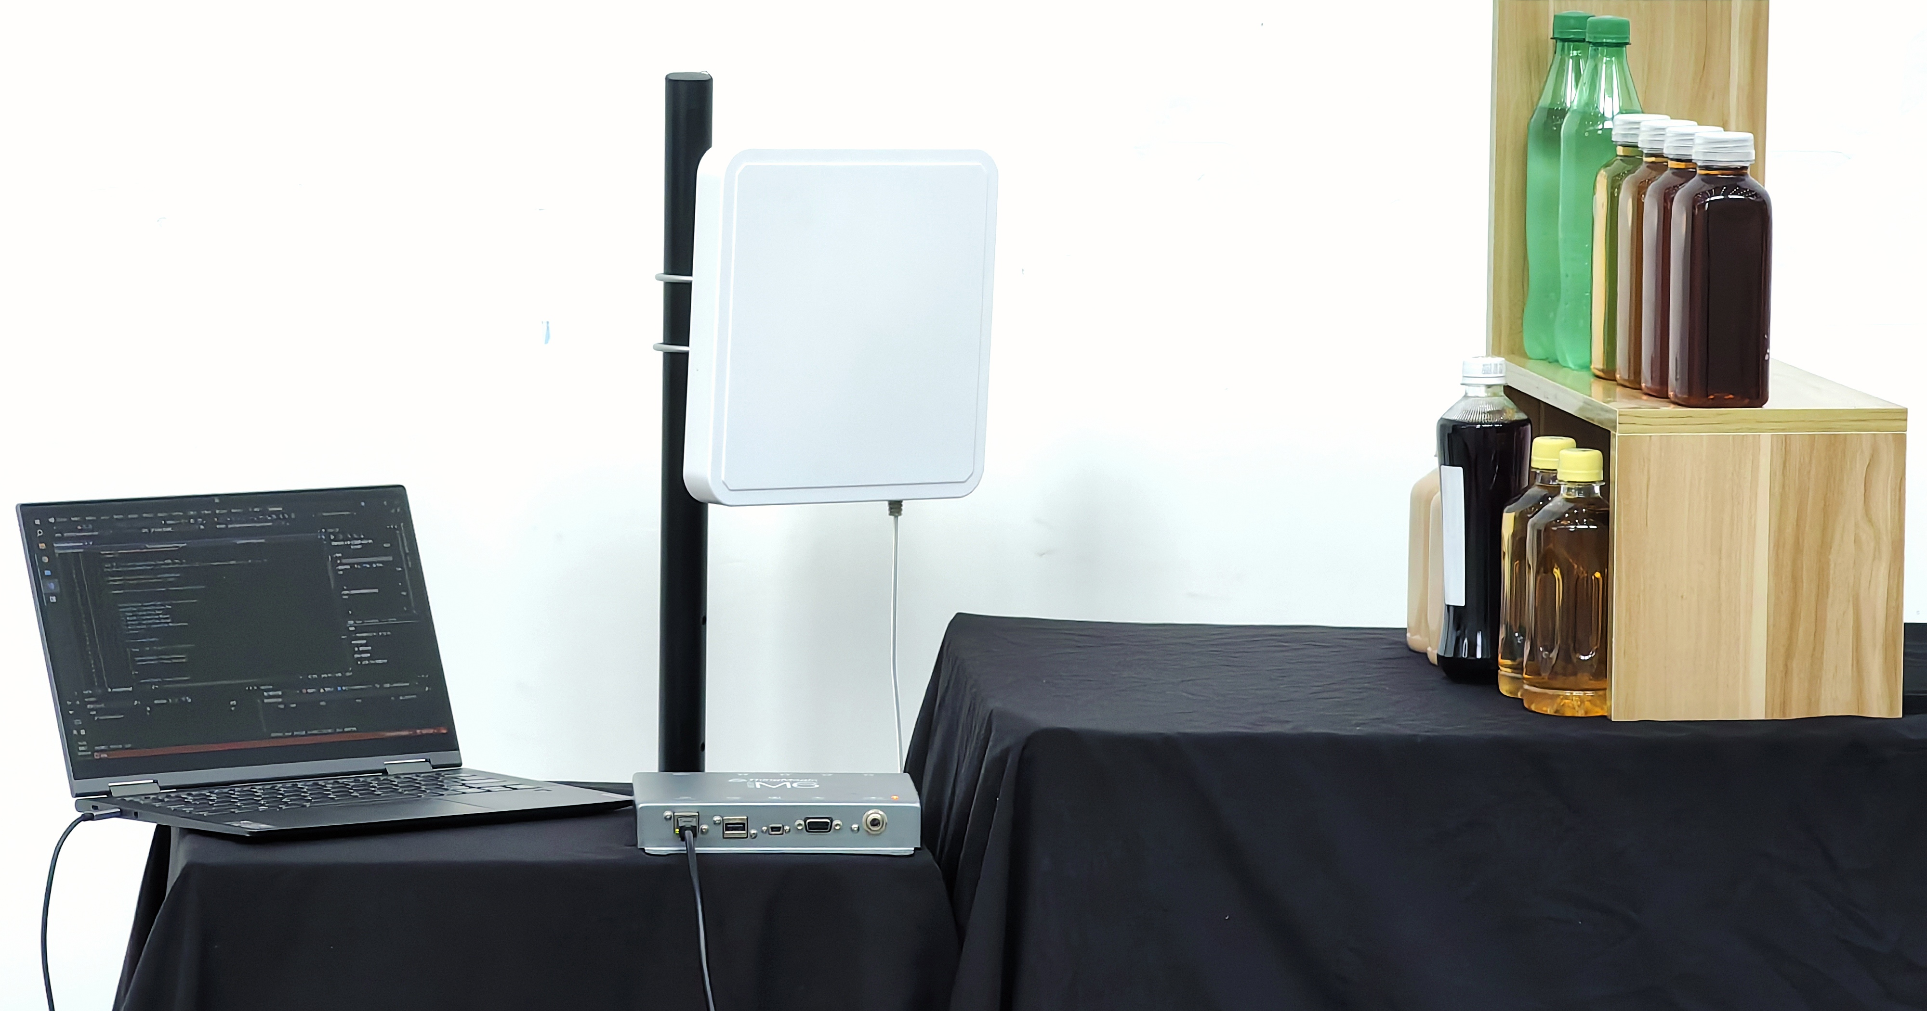
Antenna
Laptop
Tag
Reader

